Slide 2
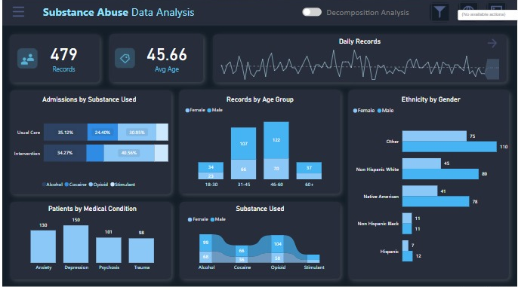

Slide 6

Revenue Analysis

